Slide 1

FPR
Lazy Bob - SDP23 Team 5
Omar Areiqat, Vedatman Basu, Redwan Rahman, Jina Song
Notes:
Gina

Slide 2
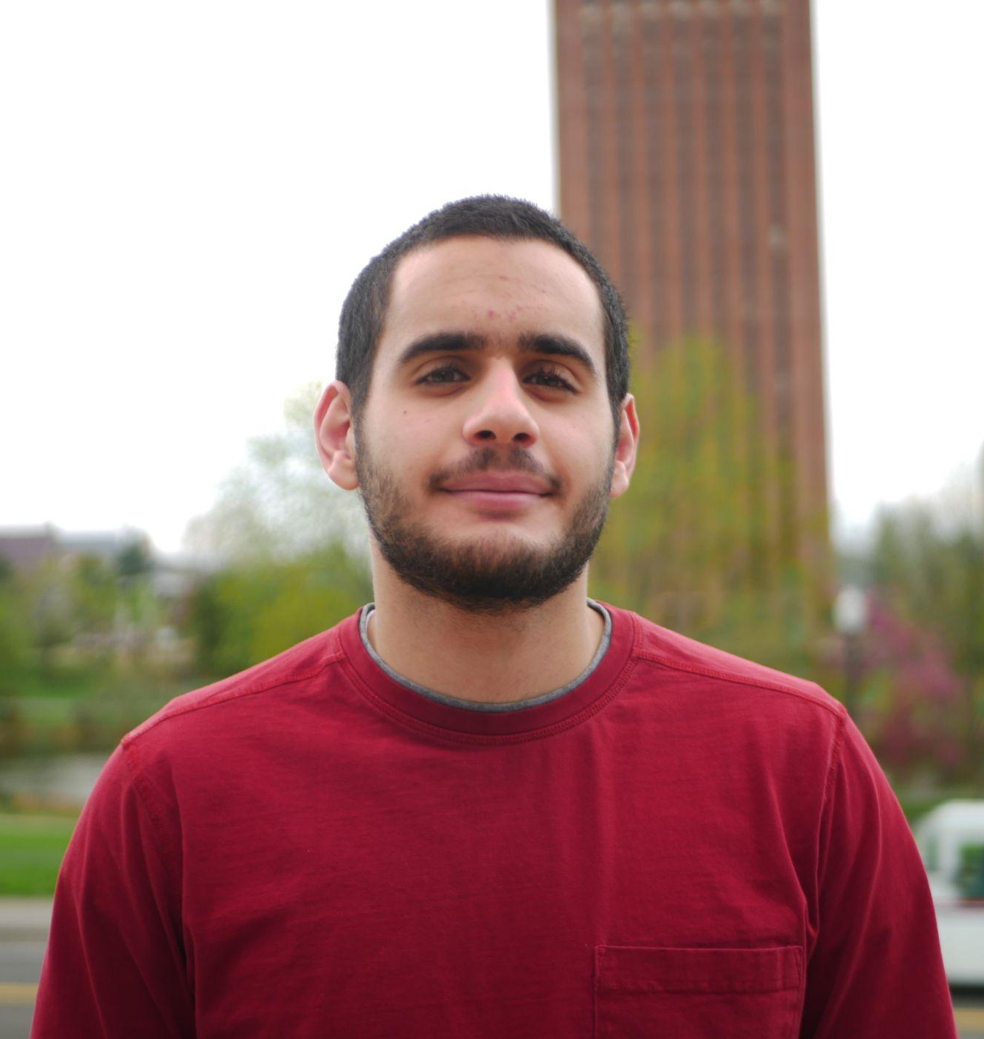
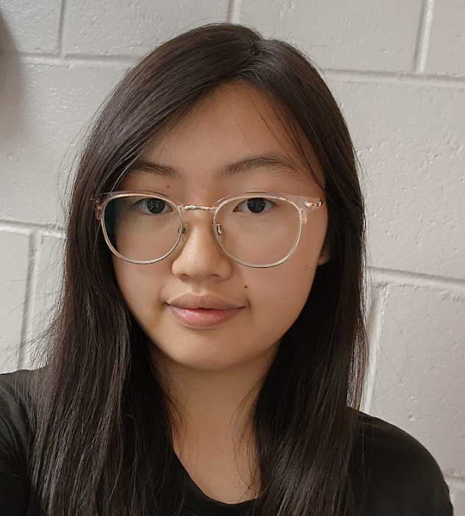

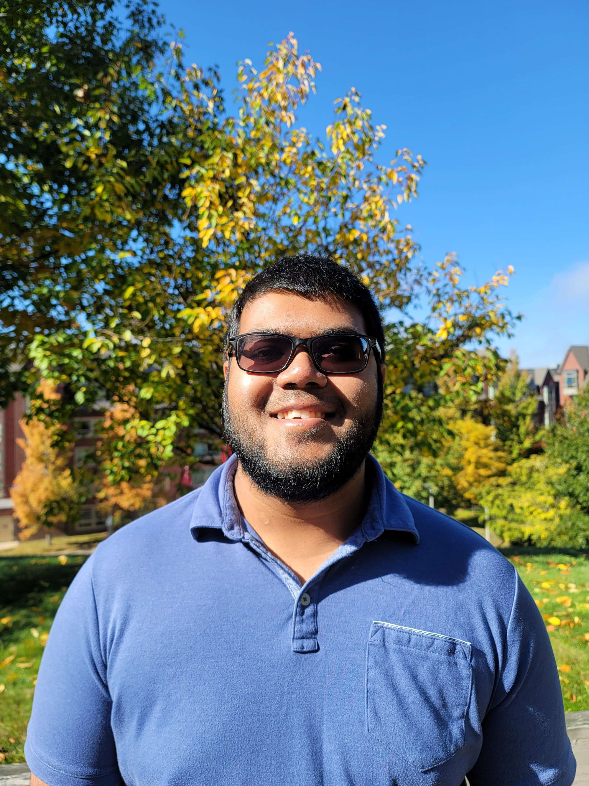

The Team
Omar Areiqat
CompE
Hardware Lead
Movement and Power
Jina Song
EE
Design Lead
Design
Vedatman Soham Basu CompE
Software Lead
Sensors
Redwan Rahman
CompE
Integration Lead
Positioning
William Leonard
Advisor
Notes:
Individual

Slide 3
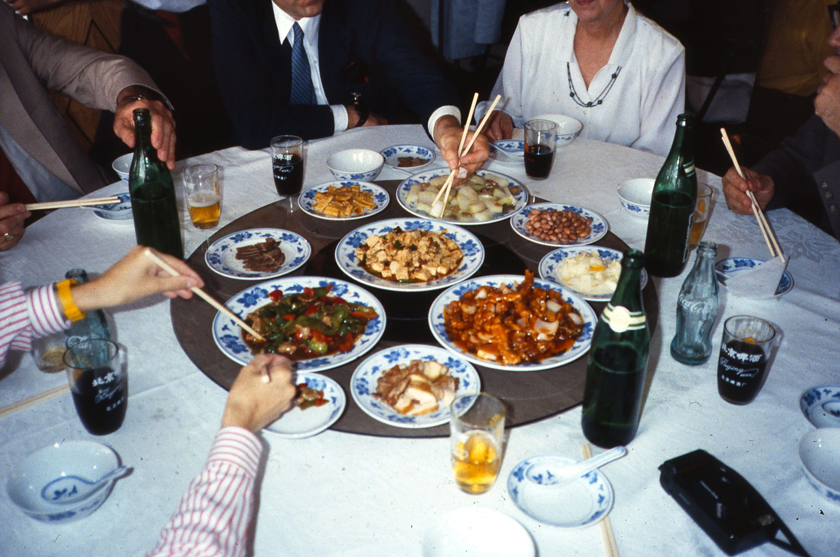
Problem Statement
Some people struggle with mundane actions in life, such as passing dishes on a large table.
Lazy Susans are nice, but only work on round tables and requires user to have reach.
What if there was a small, portable device that can move dishes across any table of arbitrary shape?
https://en.wikipedia.org/wiki/Lazy_Susan
Notes:
Soham

Slide 4
Our Solution
“Lazy Bob”: A moving coaster that approaches the user when called.
Stably transport items around a table to different users
Provide a method for the user to call the moving coaster
Adapt to the environment
Notes:
Gina

Slide 5

Proposed System
Plate 2
Coaster
θ
Coaster
Coaster
Coaster
Plate 1
Plate 5
r
Coaster
Plate 3
Plate 4
Purple: Caller
Yellow: Random Object
Notes:
Gina

Slide 6
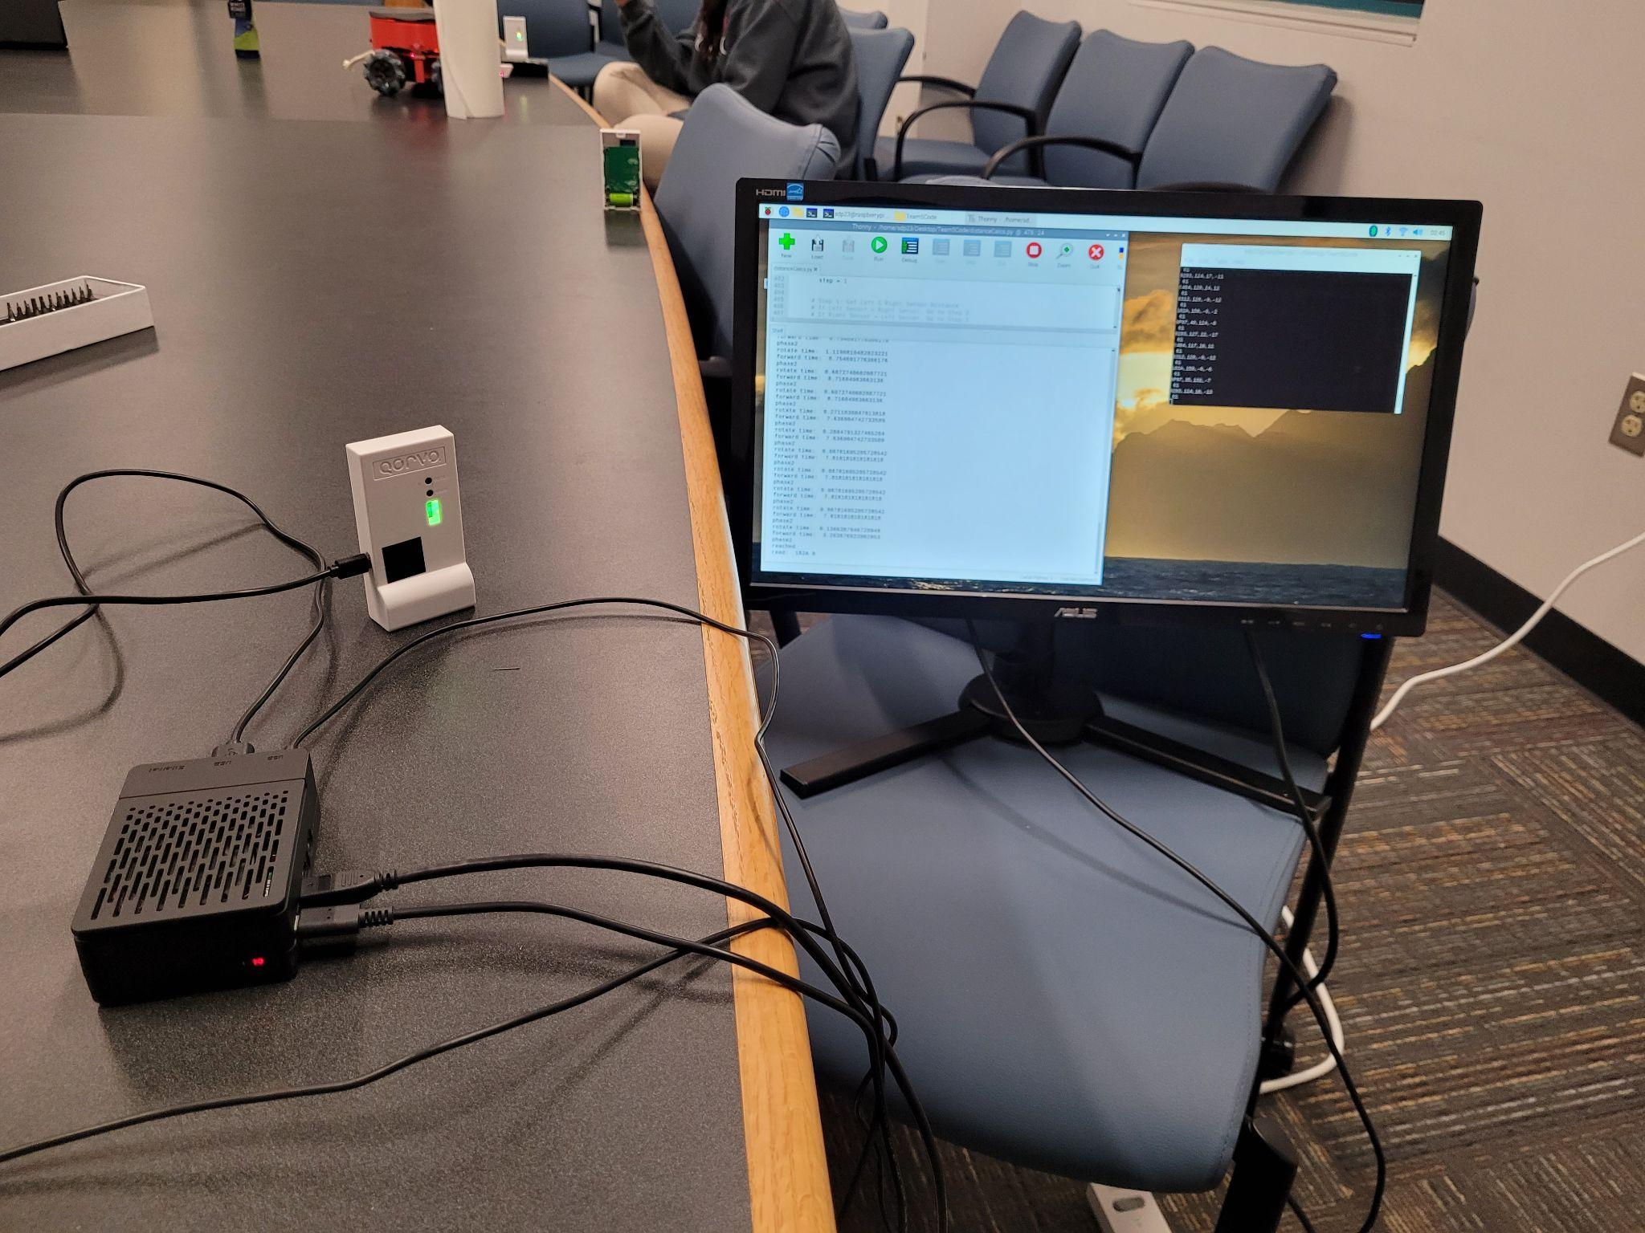
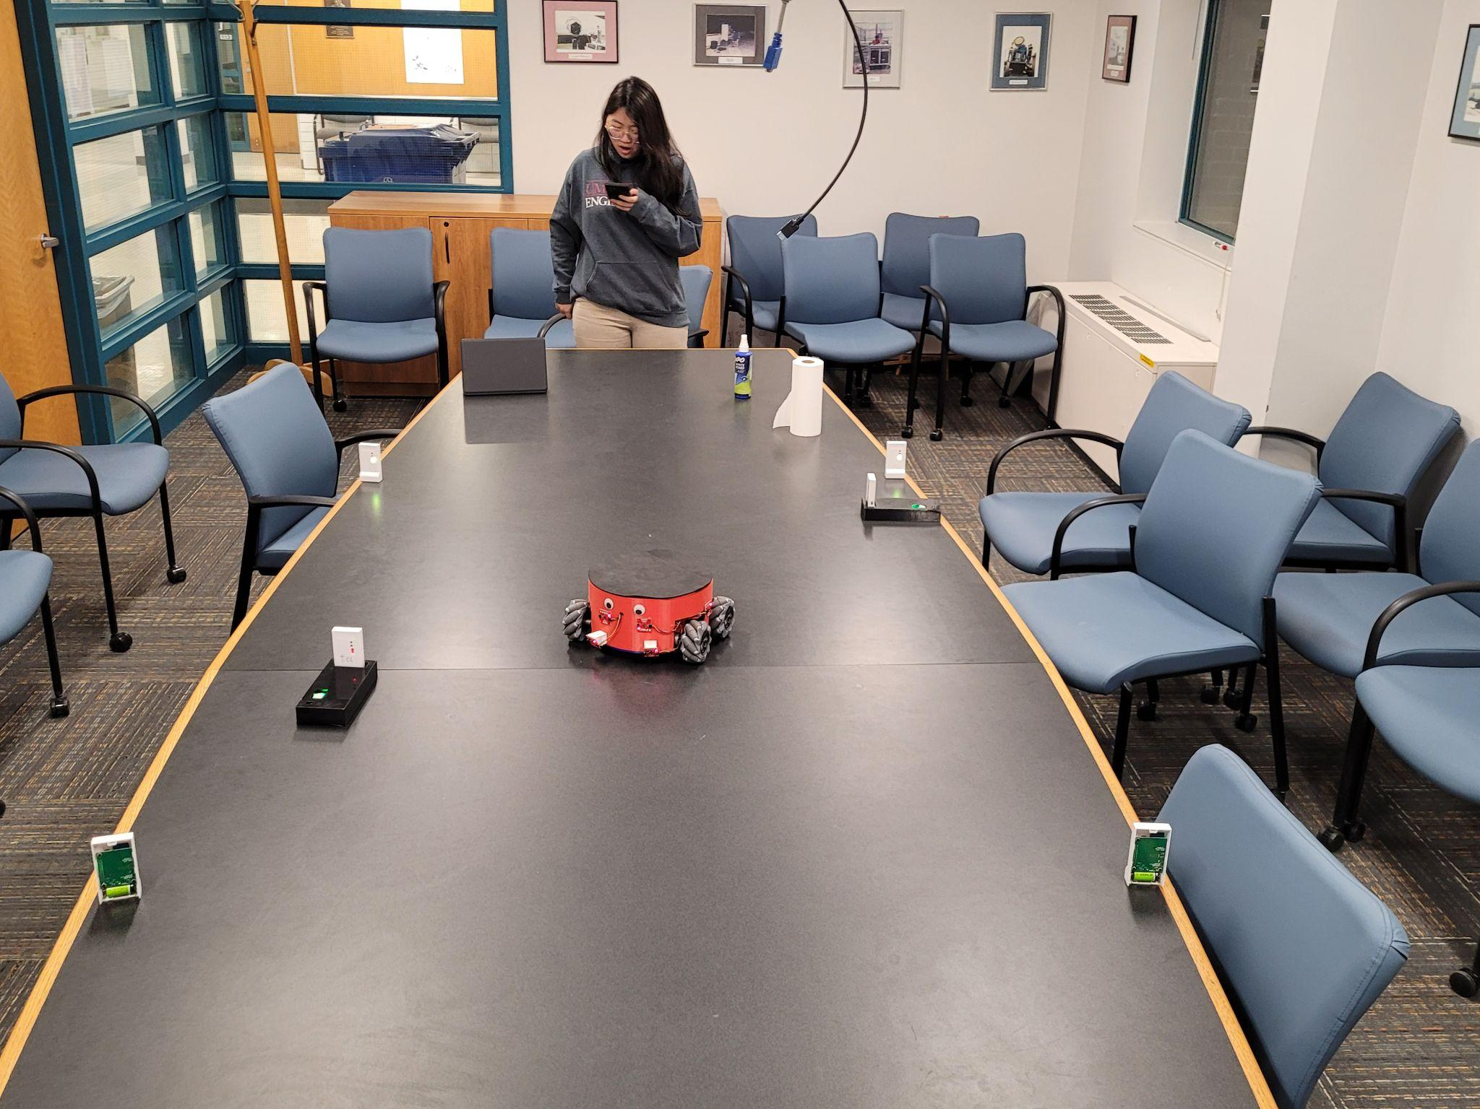
Delivered System
Pic of pi + monitor
Overview shot
Notes:
Omar

Slide 7
System Specification

Slide 8
System Specifications
Mostly full container of liquid doesn’t spill when moving
Transport items without the items falling off
Detect the edges of the table and avoid falling off
Avoid objects that are in the coaster’s moving path
Arrive at the caller to an accuracy of 15 cm between the closest points of the coaster and caller
Test Plan
Place an 80% full glass/bowl of water and visibly check that the moving coaster doesn’t spill
Put objects on moving coaster and watch if object falls
Watch if the moving coaster falls off when caller is away from the table
Put objects in path and check if moving coaster bumps into object
Use a tape measure to check the distance from destination
Notes:
Soham

Slide 9
System Specifications
Test Plan
6. Place an object that weighs 3 lbs and check if
system is stable while moving
7. Press both callers and see if the coaster moves
to the first caller only
8. Use tape measure to check coaster size
9. Find and put on irregular shaped tables and check
if it falls off
6. Support up to 3 lbs
7. System supports at least 2 callers at the same
time
8. Coaster diameter is within 30 cm
9. Be able to use the moving coaster regardless of
table shape
Notes:
Soham

Slide 10
Block Diagrams

Slide 11
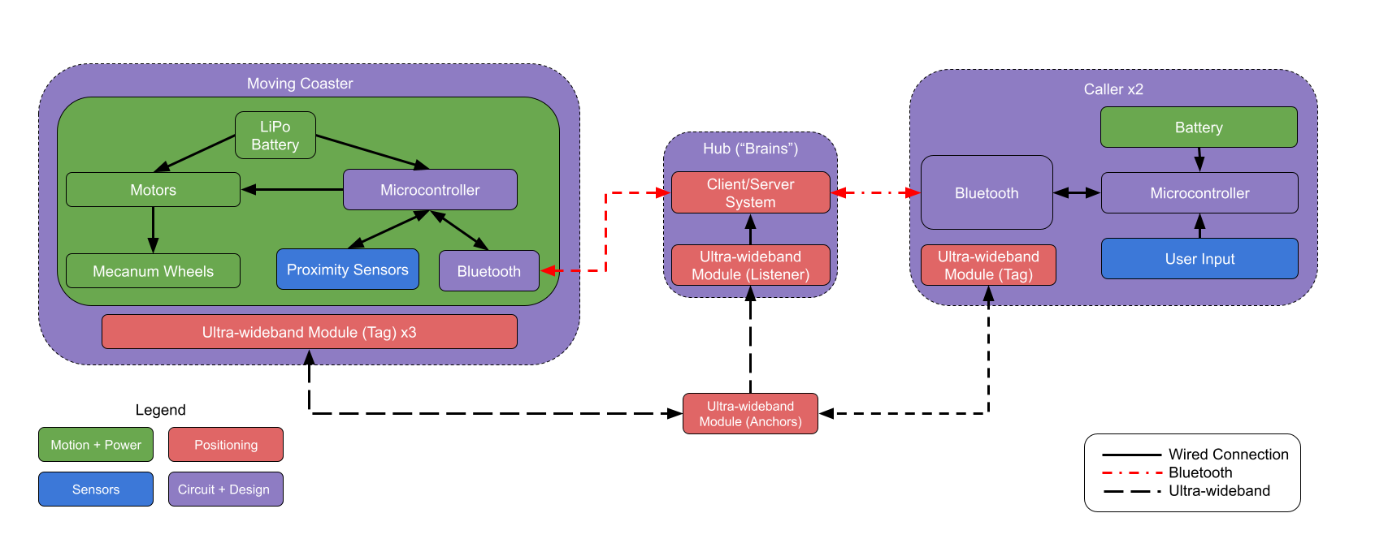
Hardware Block Diagram
Notes:
Gina

Slide 12
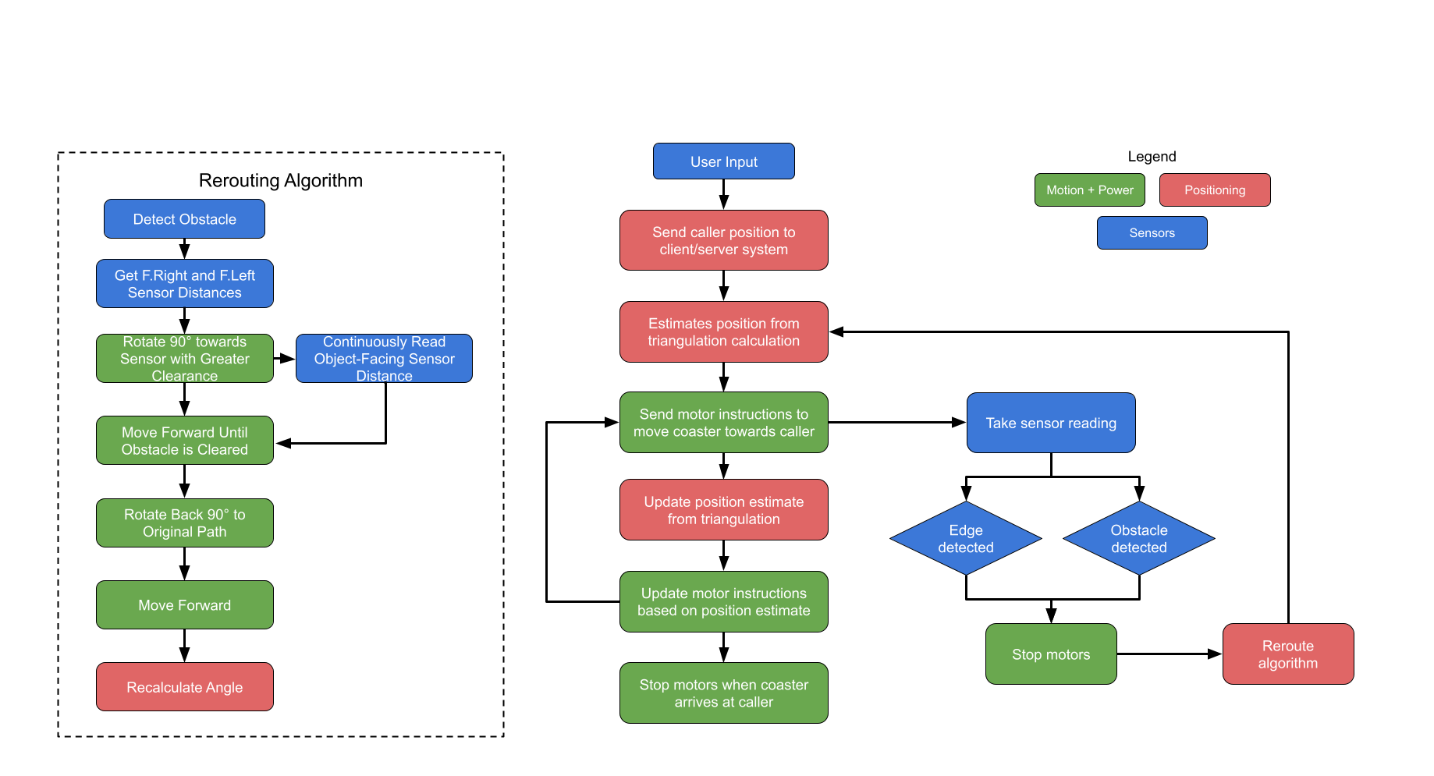
Software Block Diagram
Notes:
Redwan
- The position updating and ultrasonic sensor happens in parallel
A lot going on in that one block, should show more of the logic

Slide 13
System Hardware

Slide 14
Coaster

Slide 15
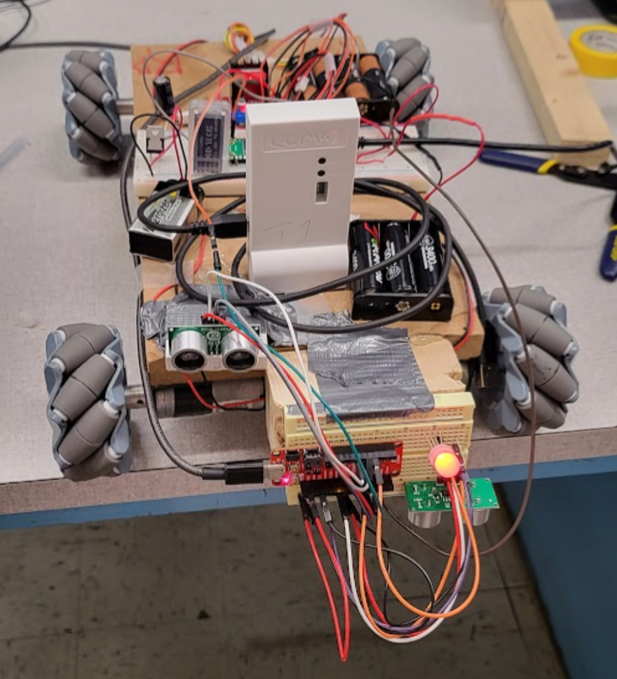
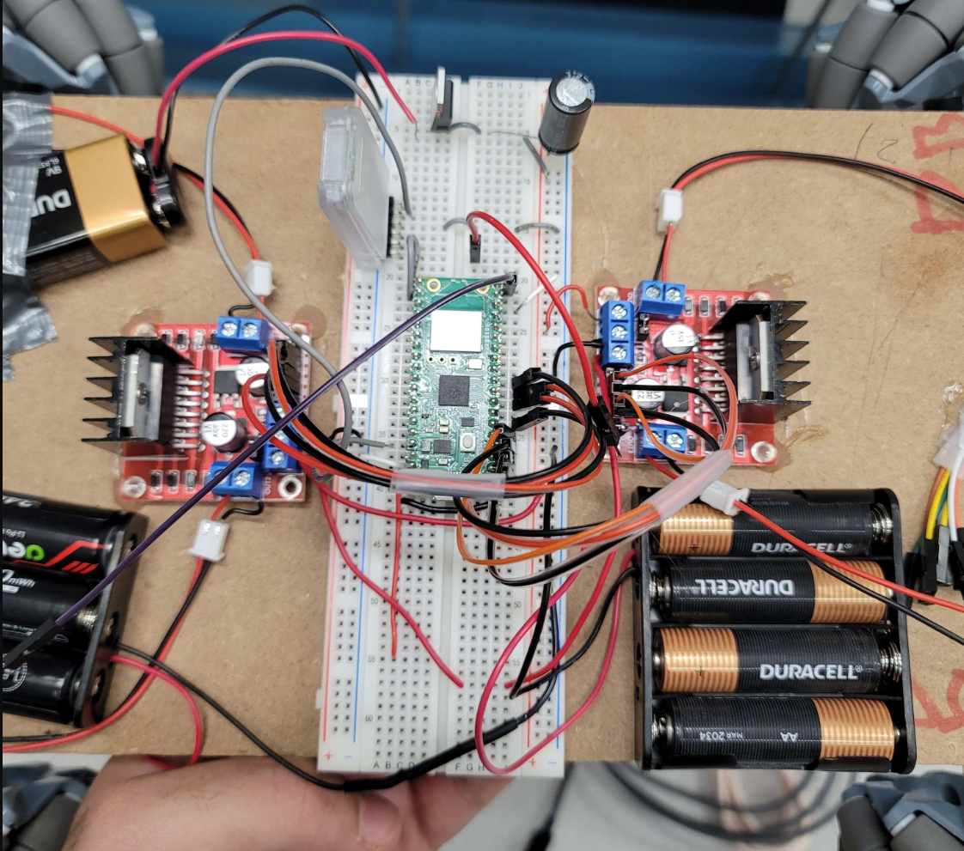
Coaster: MDR

Slide 16
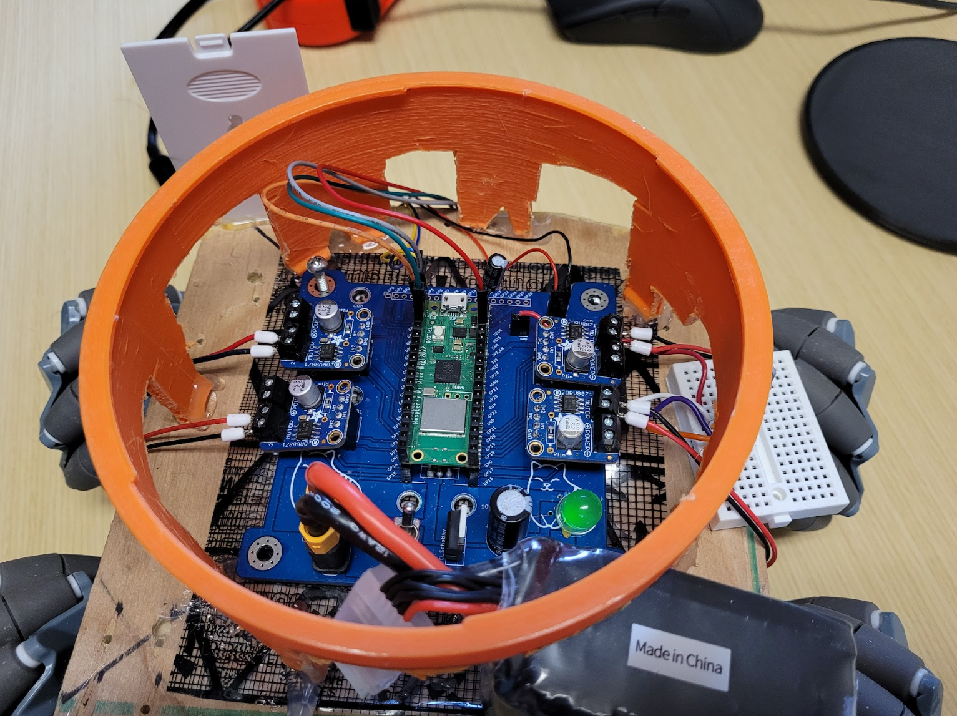
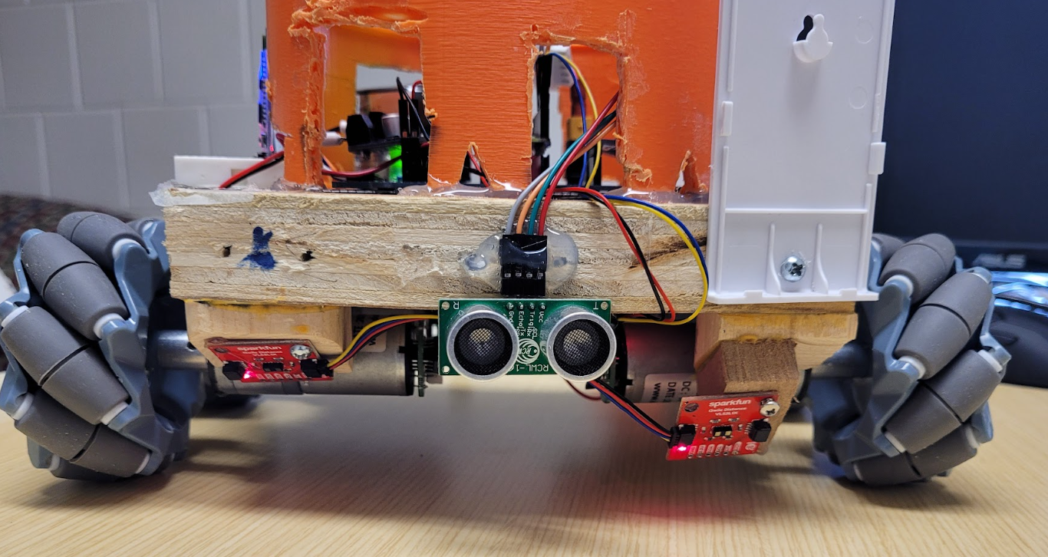
Coaster: CDR
Notes:
Omar

Slide 17
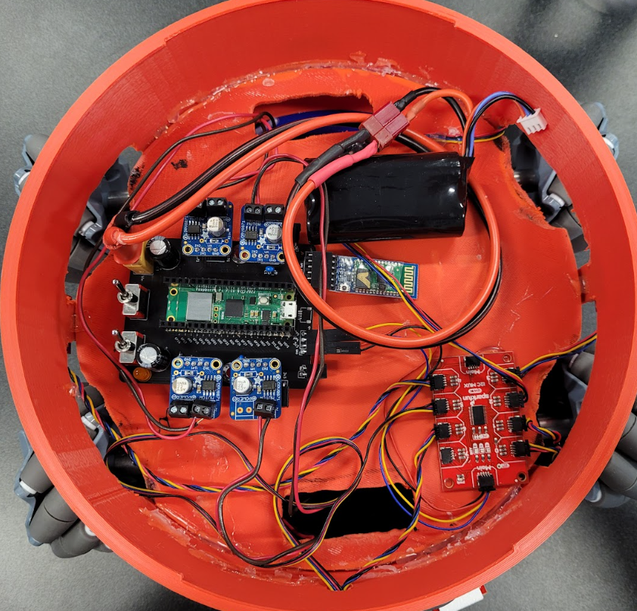
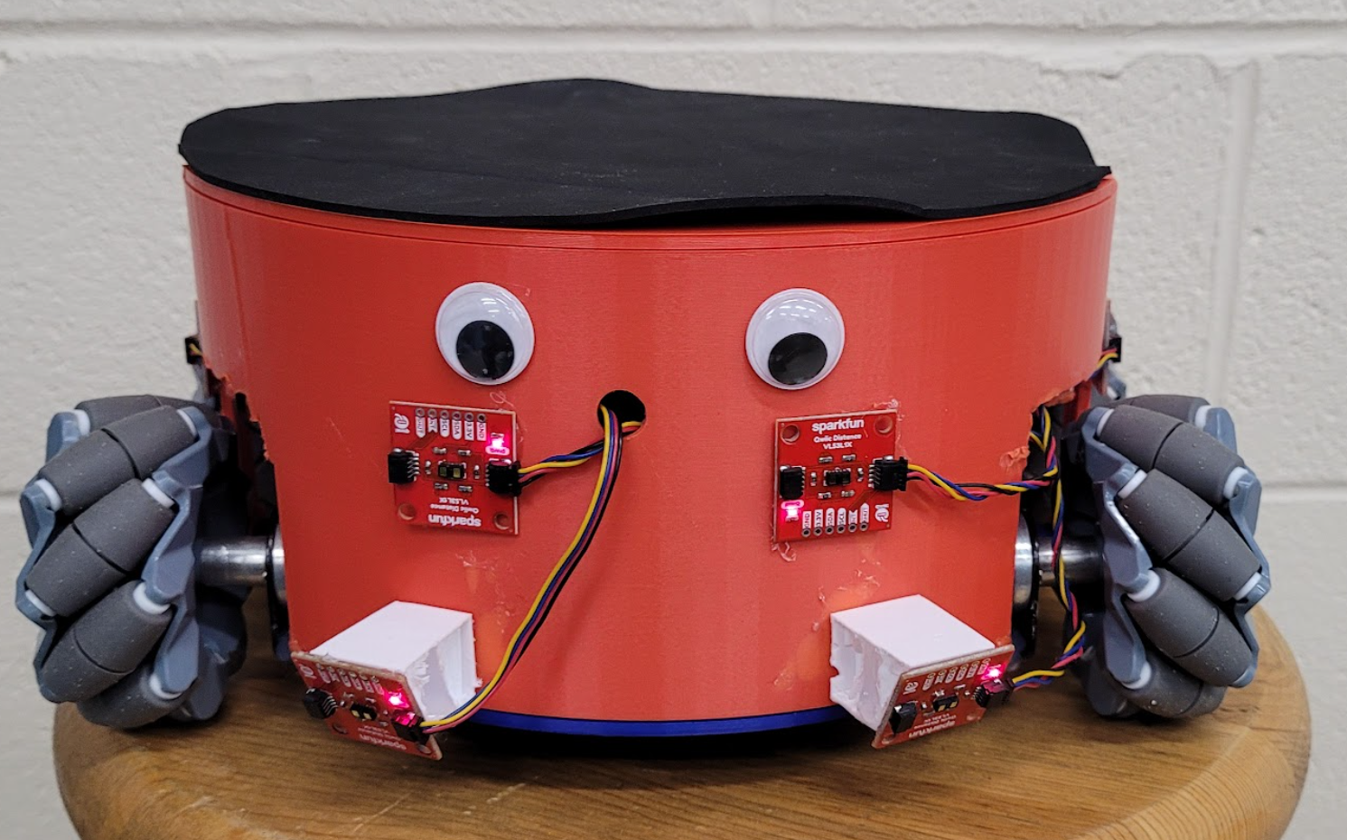
Coaster: FPR
Notes:
Omar

Slide 18
Callers

Slide 19
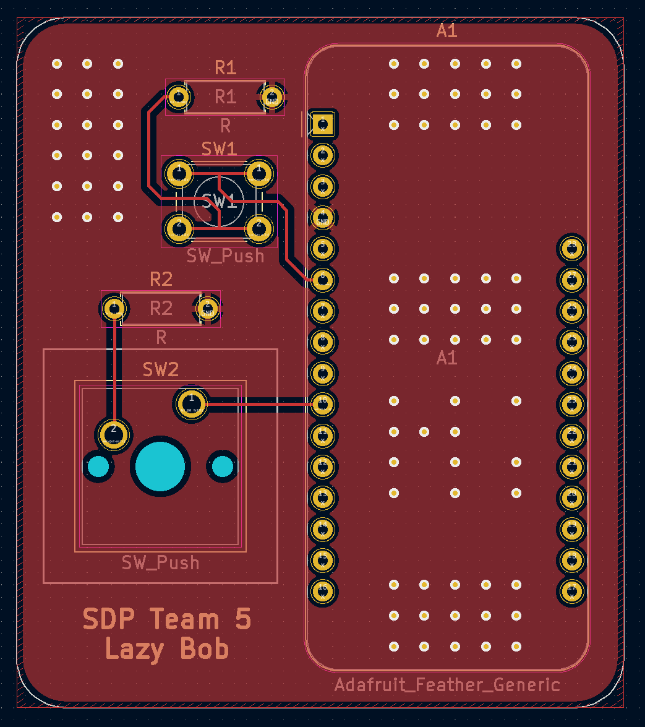
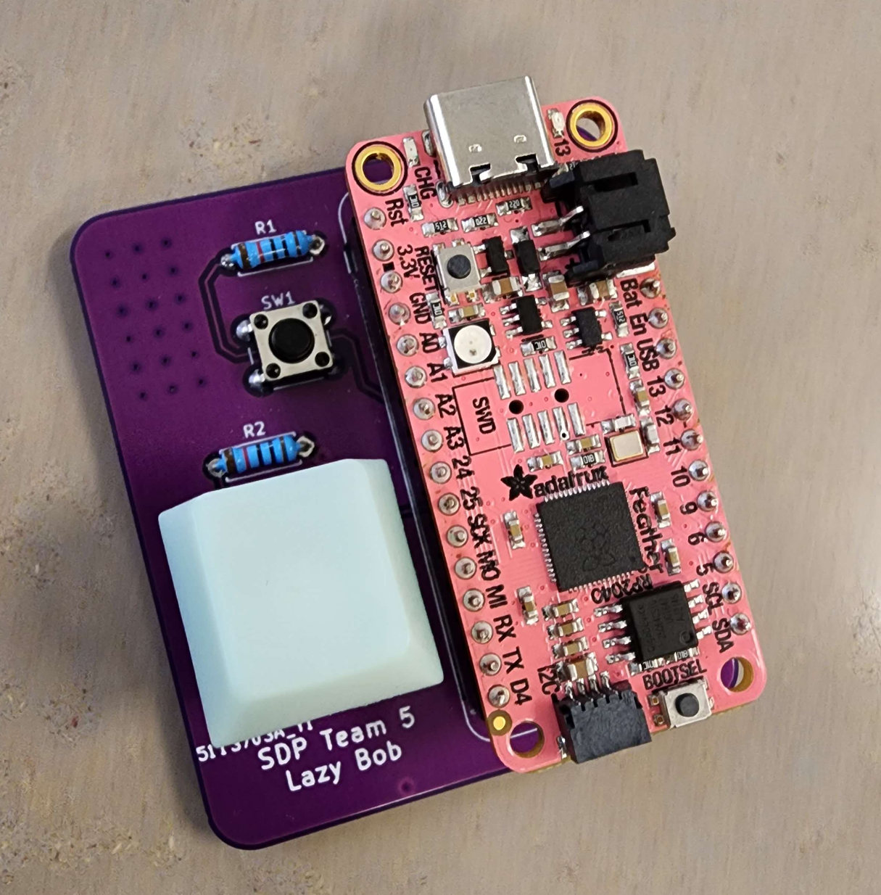
Callers: MDR
Notes:
Gina

Slide 20
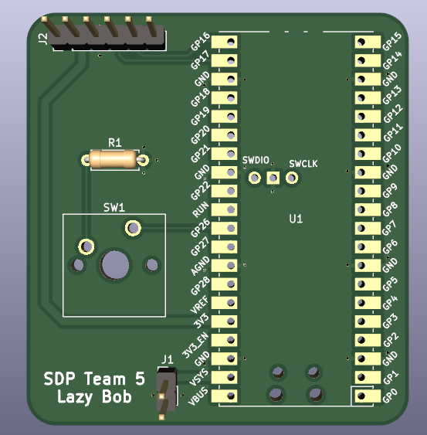
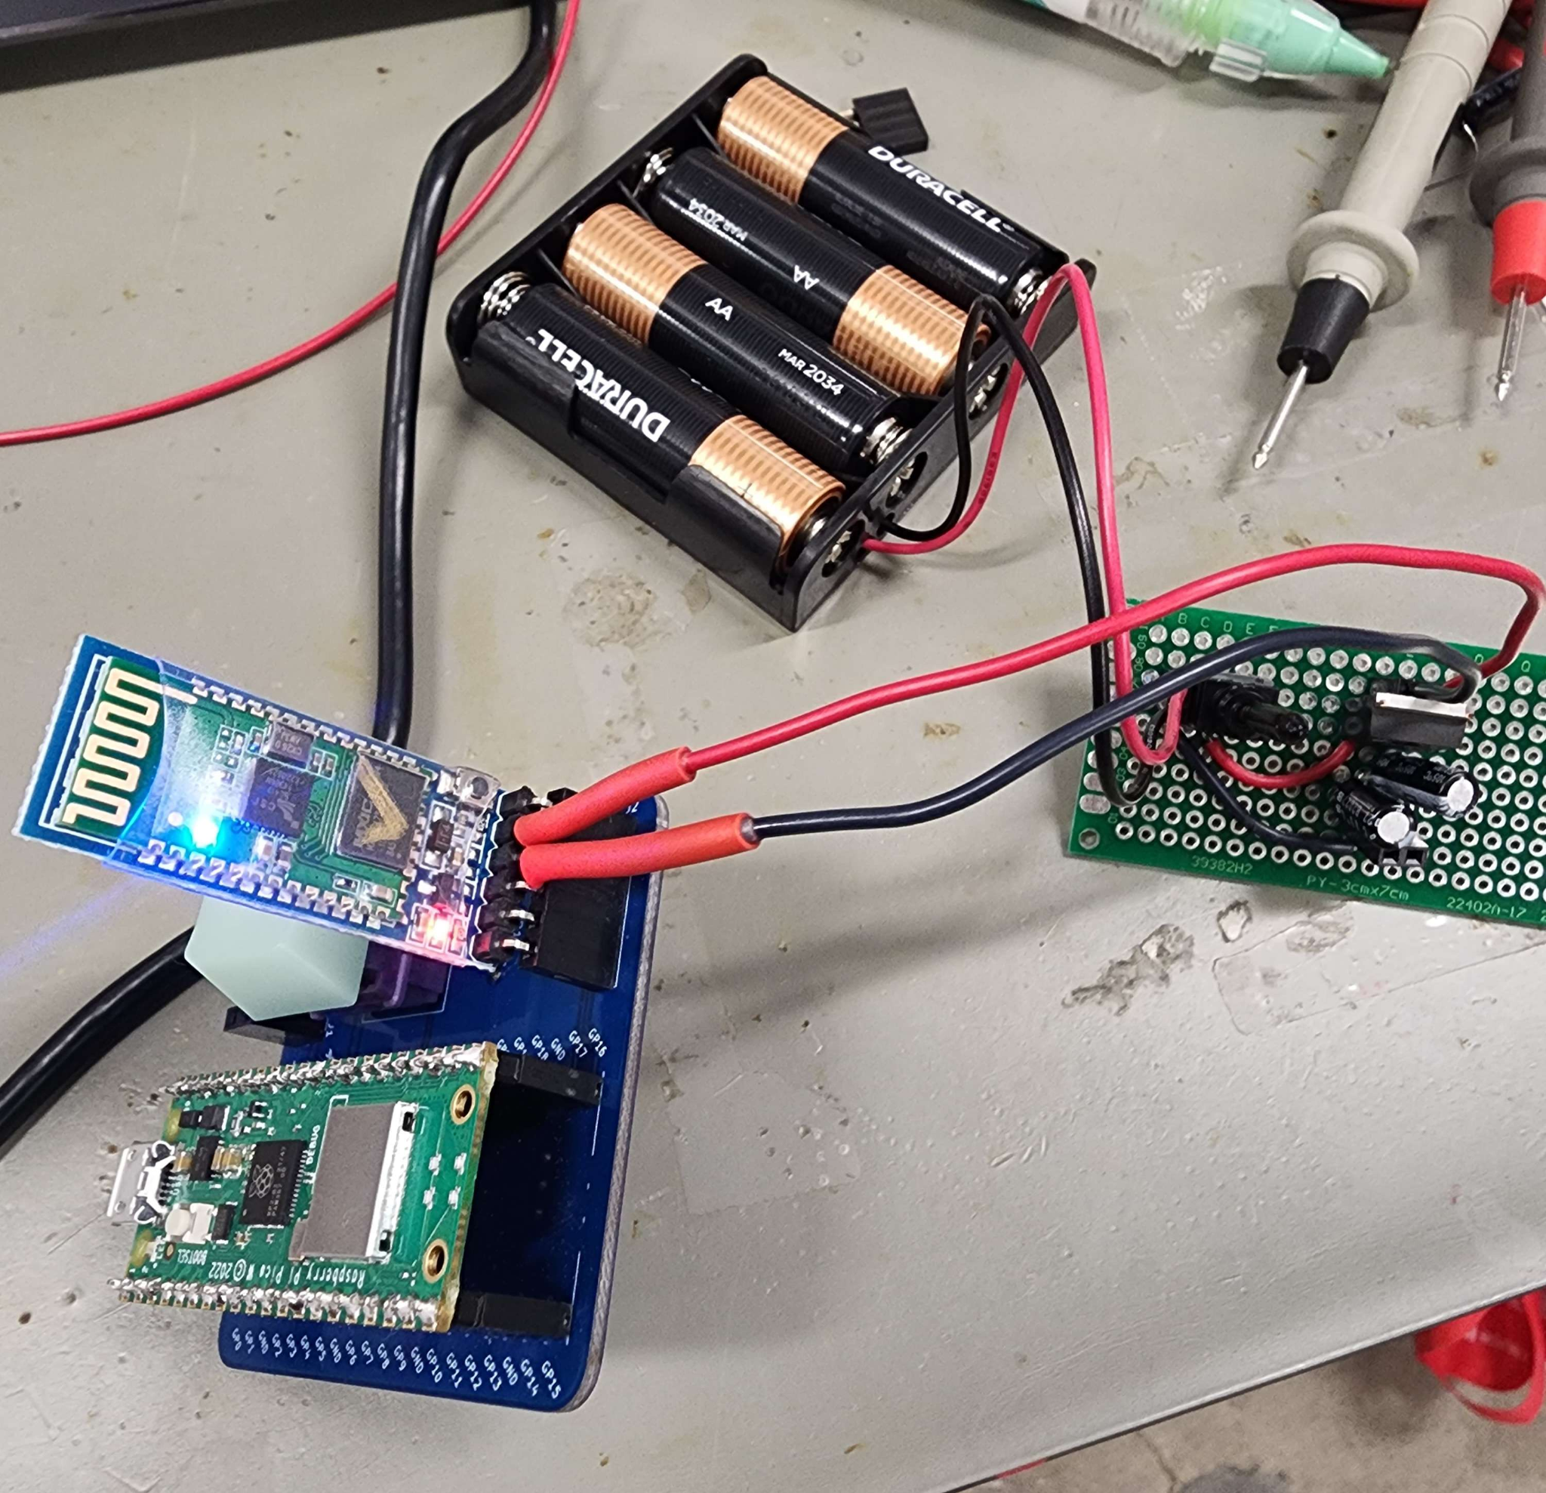
Callers: CDR
Notes:
Gina

Slide 21
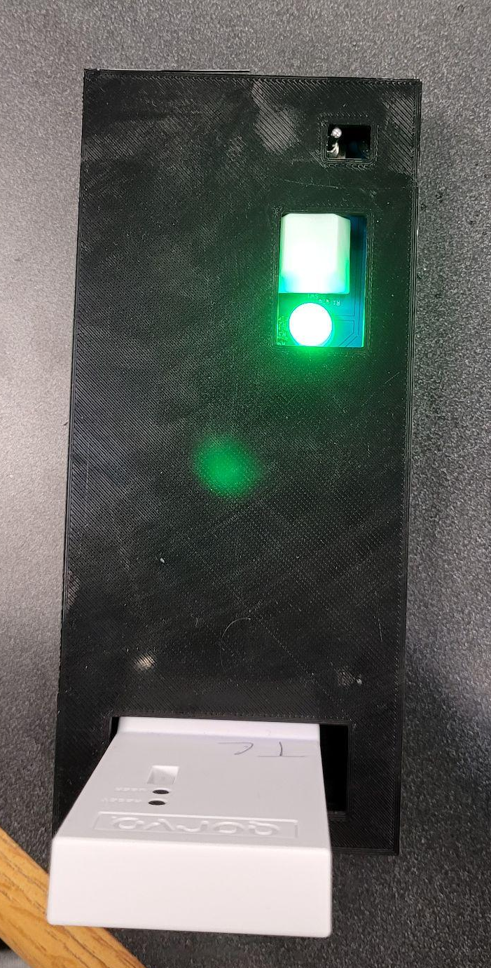
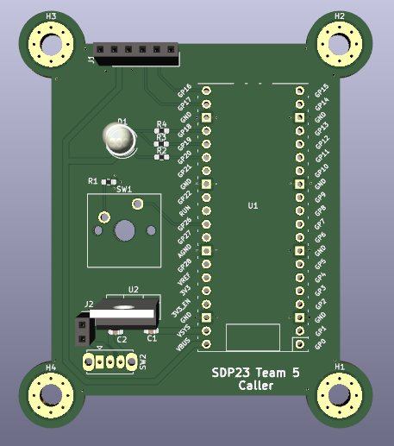
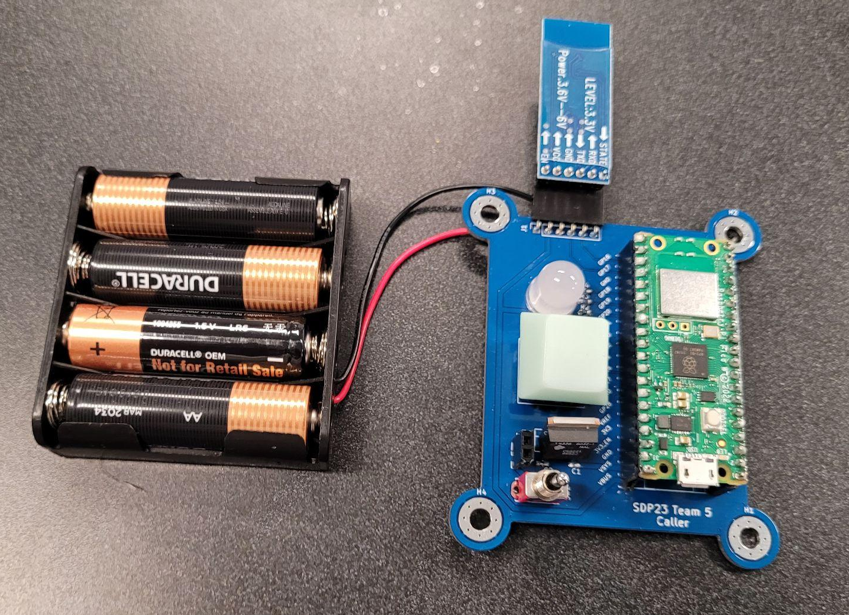
Callers: FPR
Notes:
Gina

Slide 22
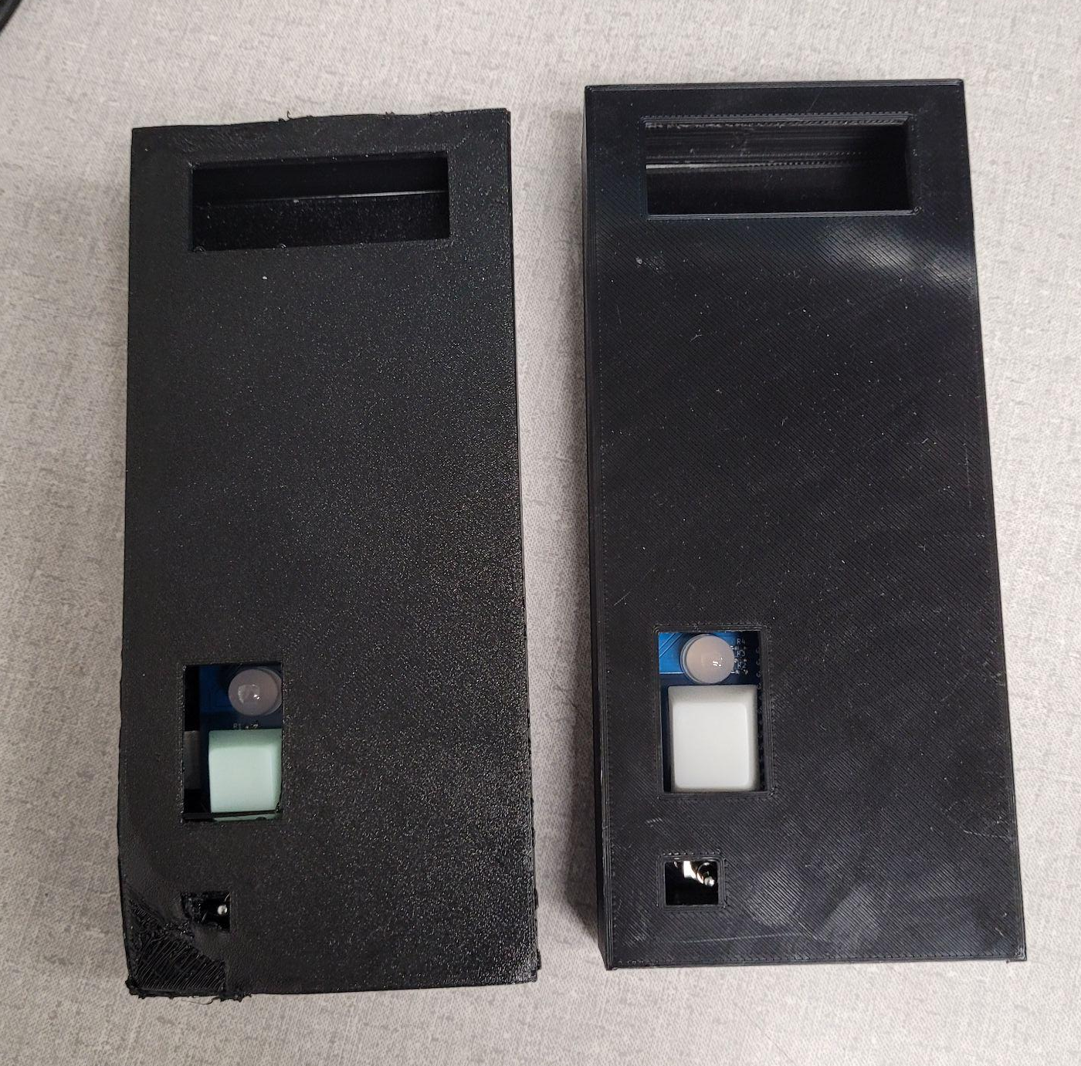
Callers: Multiple Implementation
Only 1 caller may request the coaster at a time
All other calls are ignored when in use
LED color signifies current status
Green = Ready
Blue = On The Way
Red = Busy
Notes:
Gina

Slide 23
The “Brains”

Slide 24
The “Brains”
Insert picture of pi
Notes:
Omar

Slide 25
Sensors

Slide 26
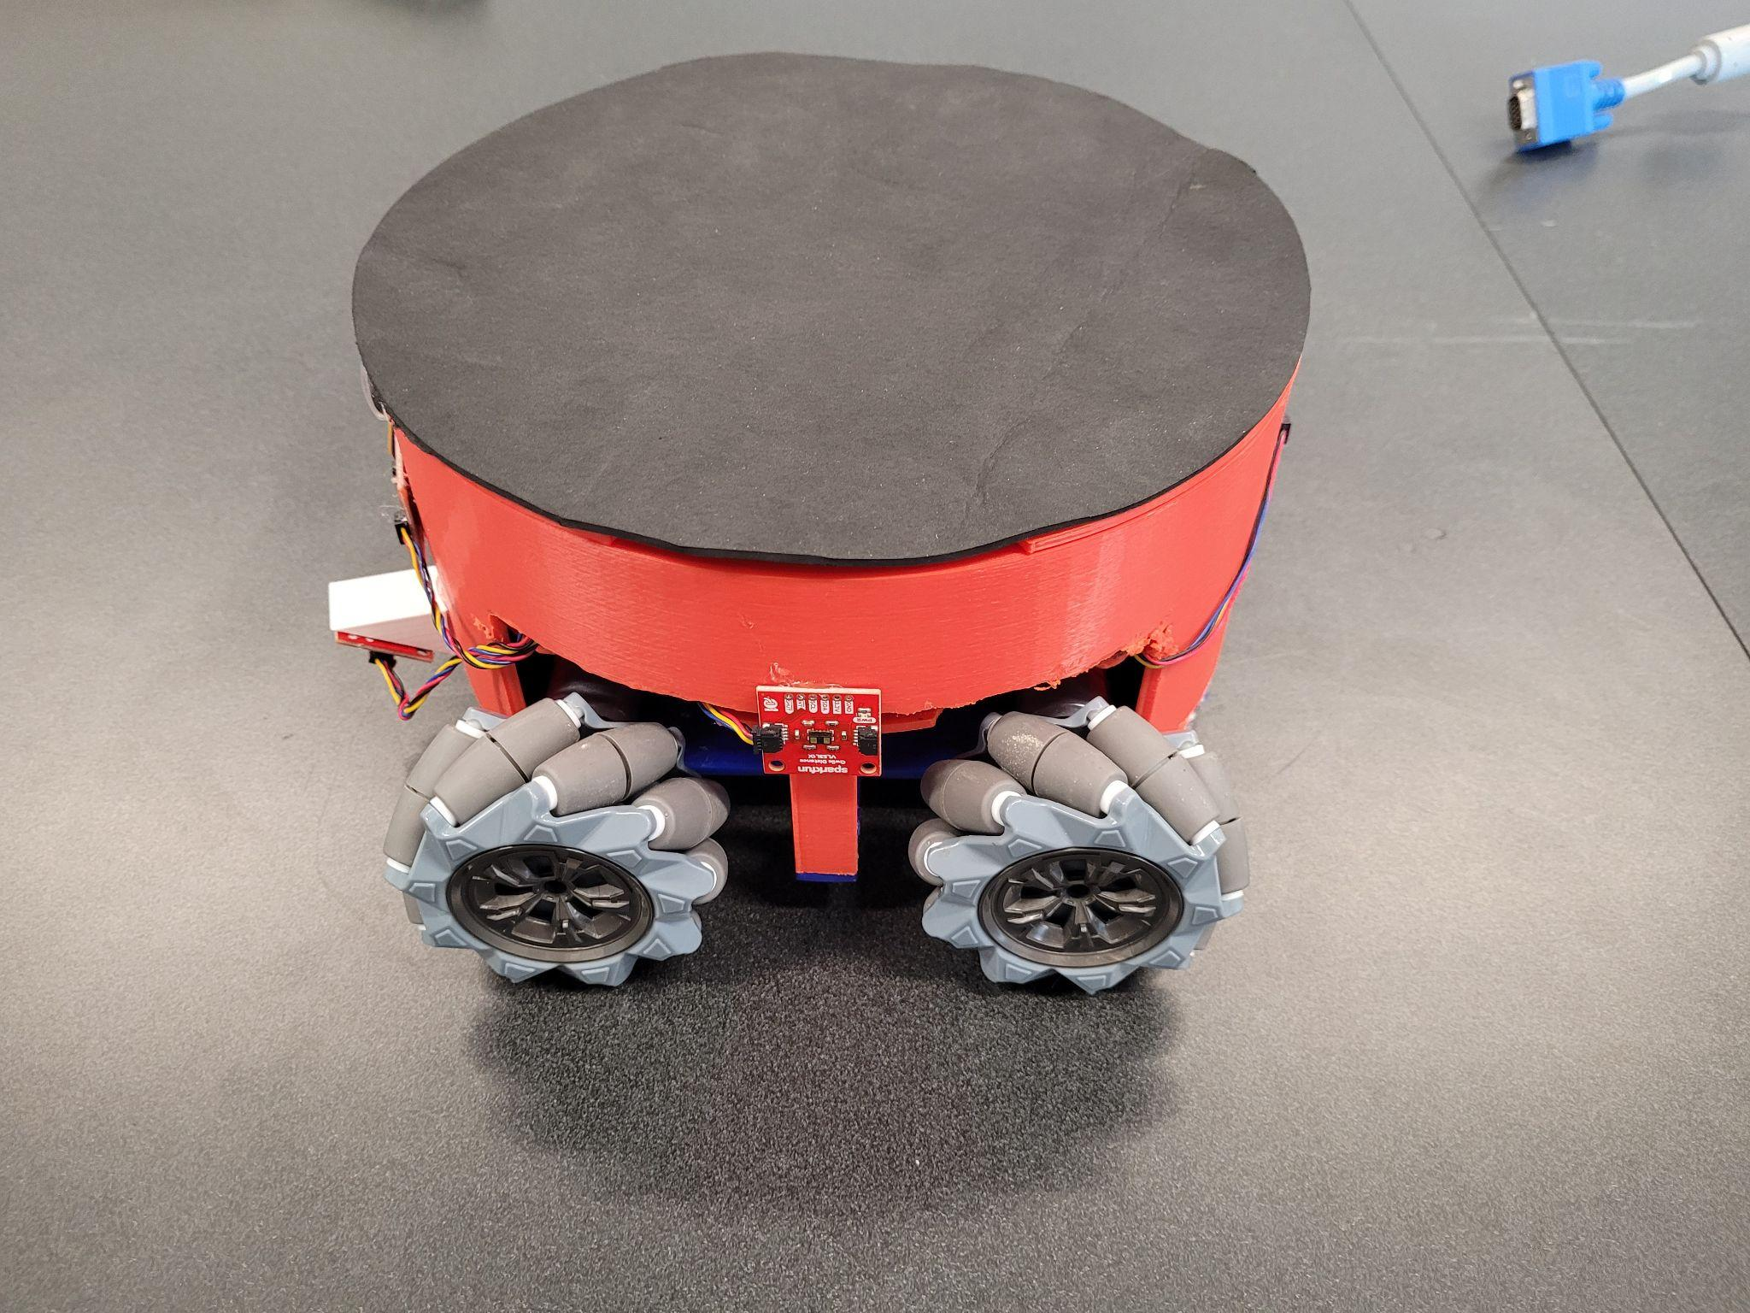
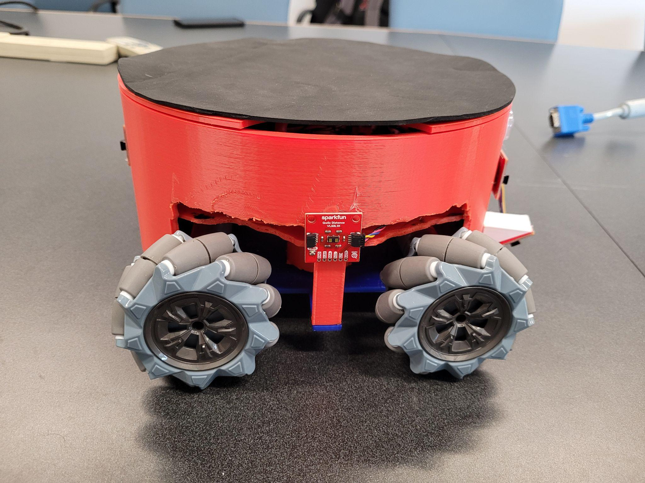
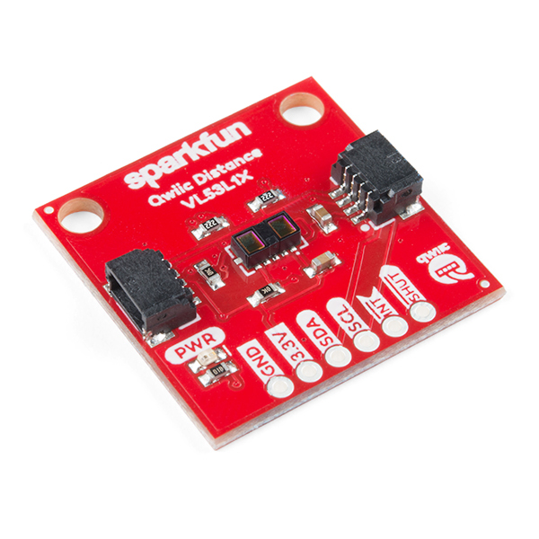
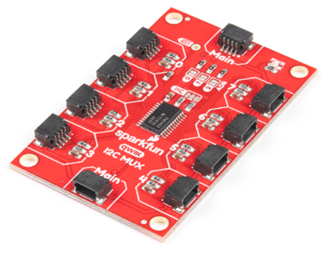
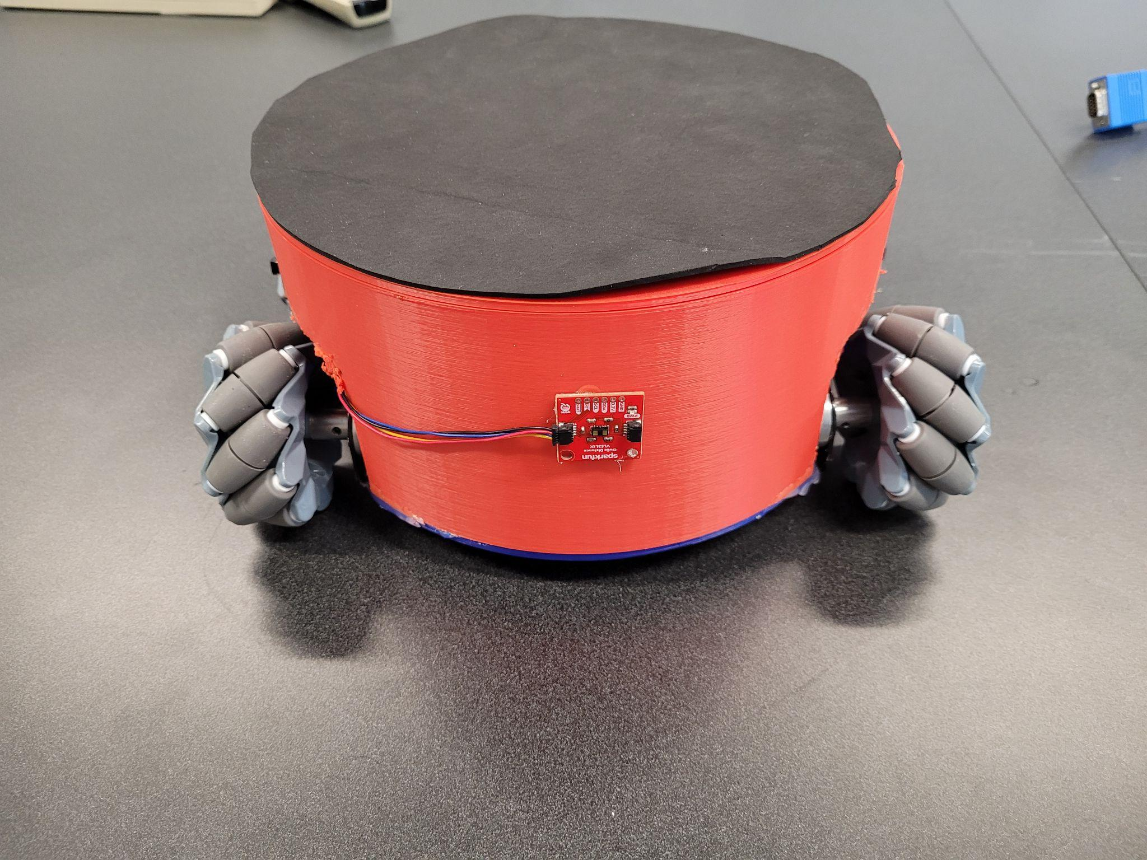
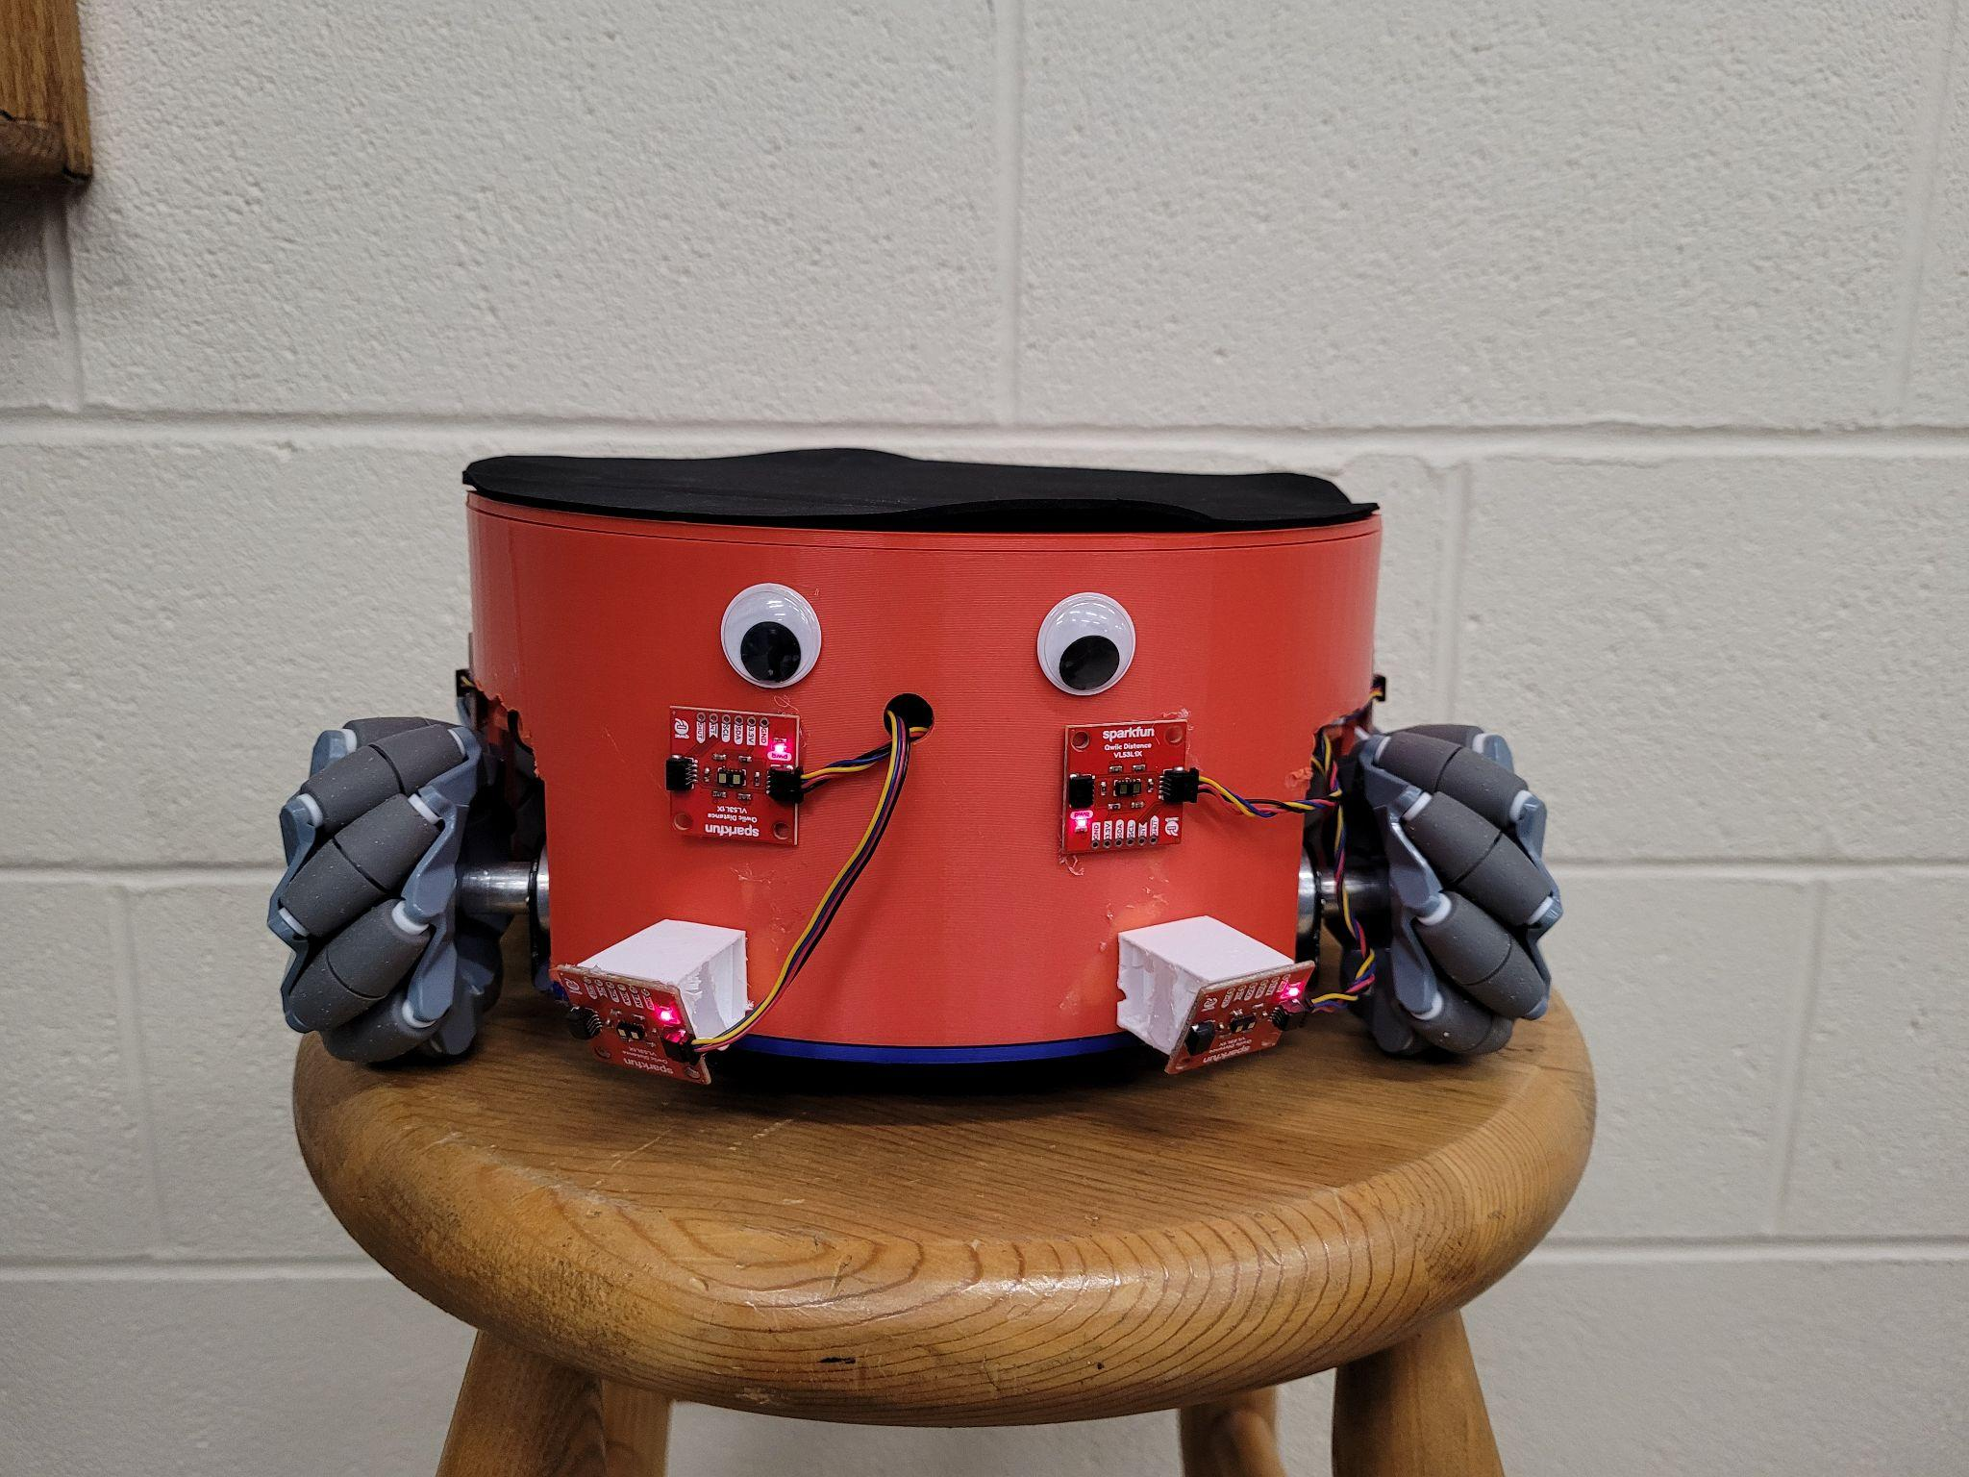
Sensors: Collision and Cliff Detection
Light ToF
Edge Detection
Collision Detection
Easy to implement many at a time
https://www.sparkfun.com/products/14722
https://www.sparkfun.com/products/16784
Notes:
Soham

Slide 27
Positioning and Rerouting

Slide 28
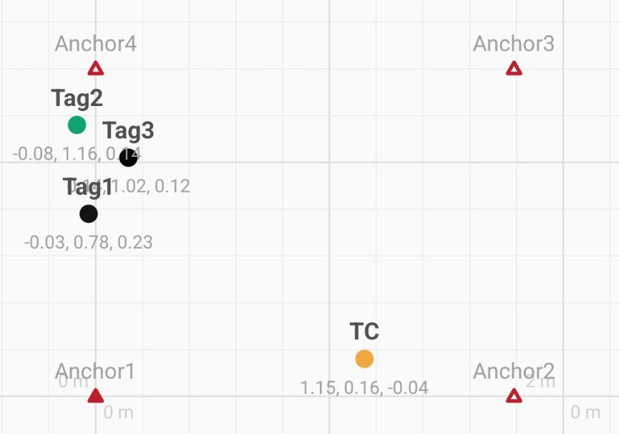
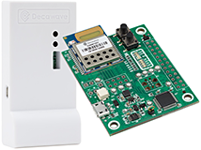
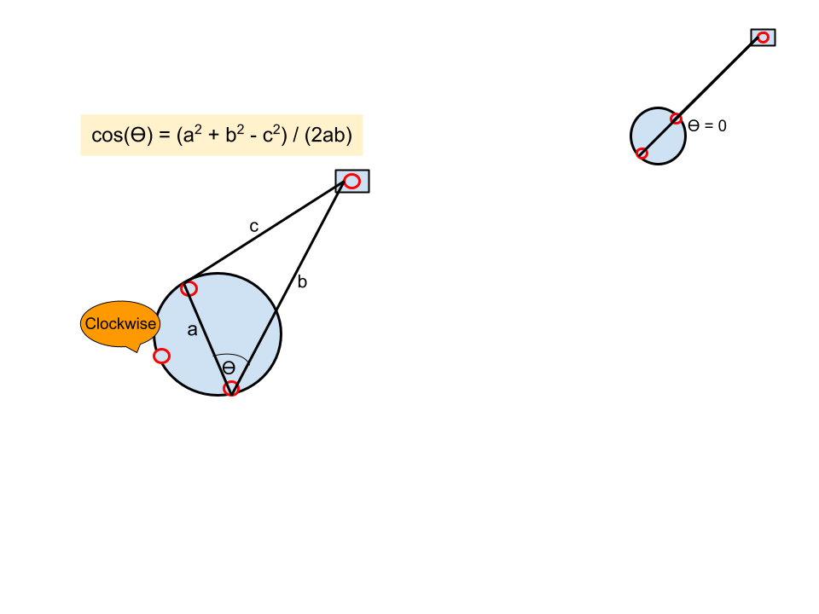
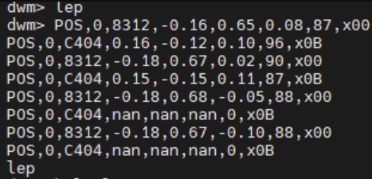
Positioning: Ultra-wideband
https://www.frontiersin.org/articles/10.3389/fnbot.2022.715440/full
https://www.qorvo.com/products/p/MDEK1001
Notes:
Redwan
For the positioning subsystem, we are still using the UWB sensors. The 4 anchor sensors are continually updating the locations of the 3 tags in use. It then plots it onto a coordinate grid like the one shown here and returns those coordinates to us. We take those coordinates and extract the theta we need to rotate and distance we travel. In the current implementation, we are only doing clockwise rotations and postponing the issue of clockwise vs counterclockwise till FPR. For FPR, we are planning to add a third tag onto the coaster itself which can easily tell us if the destination is to our right or left(cw or ccw).

Slide 29
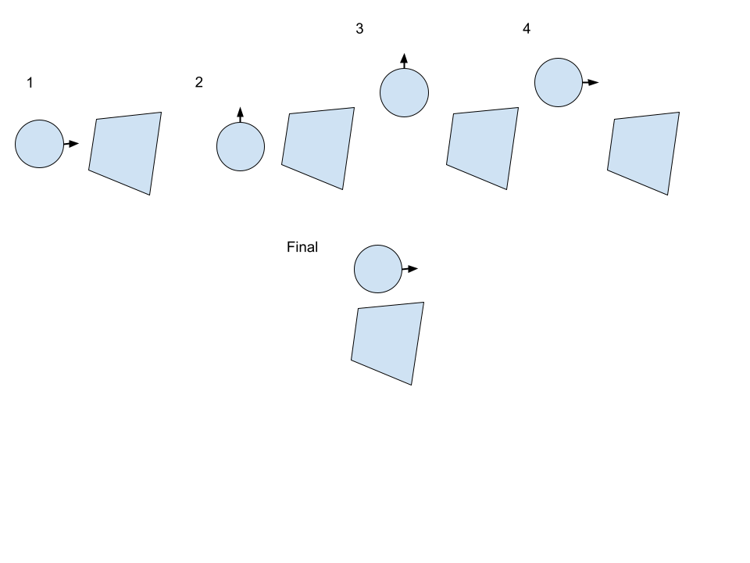
Rerouting Algorithm
CDR Implementation: Brute Force Avoidance
Lazy Bob will back up, make a step to a side, then move forward again and check whether it has cleared the object. This will repeat if not TRUE.
FPR Implementation:
Lazy Bob will detect object and make a decision on which way to turn based on the greater distance of its two forward facing distance sensors. It will then turn to that side and scan along the object facing side as it moves forward.
Once there is clearance, the Lazy Bob will return back to its original orientation and proceed forward a step before calculating angle.
Notes:
Soham
Stressing more on old vs new (no side sensor before, but can detect all around)

Slide 30
Costs

Slide 31
SDP Budget Used
Obtained List
Item Name | Source | Price $
UWB DIY Starter Kit | Link | $74.98
2 x Pico W | Wouter | $12.00
Caller PCB1 | Wouter | $22.05
6 Dof Sensors | Amazon | $15.95
New Wheels | Adafruit | $28.17
Coaster PCB1 | JLC | $6.50
Coaster PCB2 | JLC | $6.76
10 x HC05 | Amazon | $37.98
Caller PCB2 | JLC | $15.44
3D Filament | Amazon | $38.99
VL53l1x | Sparkfun | $113.81
FPR PCBs | JLC | $27.84
LiPo Battery | amazon | $24.99
Wheels | amazon | $44.99
3D Filament | Amazon | $24.99
Motors | Amazon | $43.56
$539.00
Notes:
Omar

Slide 32
Production Cost - for 1 Brains, 1 Coaster, and 2 Callers
Mass Production List
Item Name | Units | $ Unit Price | $ Item Total
UWB Sensor | 10 | $15.00 | $150.00
VL53L1X (Sensor) | 7 | $3.30 | $23.10
Pico W | 4 | $6.00 | $24.00
HC-05 (BLE Module) | 4 | $2.38 | $9.52
Coaster Chassis | 1 | $35.00 | $35.00
Caller Chassis | 2 | $7.00 | $14.00
Wheel | 4 | $3.00 | $12.00
PCB | 3 | $1.00 | $3.00
7.4V LiPo | 1 | $5.00 | $5.00
MUX | 1 | $0.60 | $0.60
Motor | 4 | $0.24 | $0.96
Cables | Misc. | $5.00 | $5.00
System Total: |  |  | 270.62
Notes:
Omar
Add quantity (and define)

Slide 33

Reminder of FPR Deliverables
Improved Consistency on Movement
Move movement controls to the coaster itself for better consistency
Better Rerouting Algorithm
Using more sensors, implement a better way to navigate
2nd Caller
4. Chassis for Coaster
a. 3D print chassis for each part
of the system
5. Updated PCB
a. Motion - Further optimizations
b. User input - Add 5V and LED
Notes:
Redwan

Slide 34
Demo + Q&A

Slide 35
Videos
Straight Shot & Edge Detection & Button Colors & Button Locking:
https://drive.google.com/file/d/1MCR_ZY55AZKxfdinNN-QkkkYKjTHUI0m/view?usp=share_link
Obstacle Avoidance:
https://drive.google.com/file/d/1MJIGTPBW8F-LTN8W8kColtyC7Dfij1dU/view?usp=sharing
https://drive.google.com/file/d/1MNN1SpP66sIA2yZz_bj1Dcg2ajXkuQTa/view?usp=sharing

